Slide 1
Hesse K-8 is the P.L.A.C.E. to Be!
2020-2021 Virtual Open House
Hesse K-8 School

Slide 2
Welcome to the Hesse K-8 1st Grade
Virtual Open House for the
2020-2021 School Year

Slide 3
Reminders to Parents:
This virtual meeting is simply for information. Any confidential information about your student should not be shared during this time. If there is important information you need to share with me about your child, please email me at jessica.fowler@sccpss.com.
Please remember to mute your microphone to help reduce background noise.

Slide 4
Greetings from Principal Newman
Kimberly Newman, Hesse K8 Principal
kimberly.newman@sccpss.com
MISSION POSSIBLE: Blasting Off to New Explorations!

Slide 5
Meet our Assistant Principals.
Erica Ross
Grades PK-4
Jennie Thompson
Grades 5-8
Erica.ross@sccpss.com
jennie.thompson@sccpss.com

Slide 6
WHO TO CONTACT FOR ASSISTANCE:
REGISTRATION/POWER SCHOOL QUESTIONS: (912) 395-6440
Michelle Conner, Secretary laurie.conner@sccpss.com
Melissa Fields, Secretary melissa.fields@sccpss.com
Robin Steplight, Administrative Secretary robin.steplight@sccpss.com
Cookie Brookshire, Information Specialist Cookie.brookshire@sccpss.com

Slide 7
WHO TO CONTACT FOR ASSISTANCE:
TECHNOLOGY ASSISTANCE: (912) 395-6440
Donna Sikes, Media Specialist donna.rudser-Sikes@sccpss.com

Slide 8
WHO TO CONTACT FOR ASSISTANCE:
FAMILY SUPPORT: (912) 395-6440
Mark Fordham, PK-2nd grade Counselor mark.fordham@sccpss.com
Stephanie Small, 3rd-5th grade Counselor stephanie.small@sccpss.com
Bathsheba Cherry, 6th-8th grade Counselor bathsheba.cherry@sccpss.com
Stacey Reid, School Social Worker stacey.reid@sccpss.com
Erin Miller, School Nurse erin.miller@sccpss.com
Samantha Ramsey, School Nurse, samantha.ramsey@sccpss.com

Slide 9
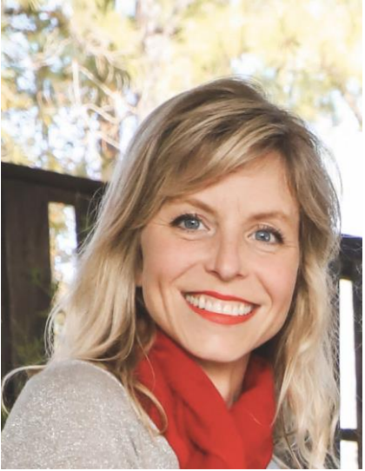
WHO TO CONTACT FOR ASSISTANCE:
Mrs. Stacey Reid, School Social Worker
My Schedule: 8am-4pm M-F
Email: Stacey.reid@sccpss.com
Phone or Text: 912-659-4080
I would love to hear from you. Parents, please reach out and introduce yourself and your student during the first week of school. Send a quick email, text, or call. I want to get to know you and your child!
SERVICES
• Serve as a connector between home and school • Advocate for student services • Help with crisis and emergency needs • Provide emotional support and counseling • Provide resources and services to students and families • Address barriers to attendance

Slide 10
Hesse K8 PTA Membership
Please support your school by joining Hesse K8 PTA…
Michele Smith, PTA President presidenthessek8pta@gmail.com
Join PTA today! Memberships are $5 per person.
Use the link below to join online.
https://hessek8pta.memberhub.store/
Don’t HIBERNATE…. PARTICIPATE!!

Slide 11
Hesse Information
Connections
https://docs.google.com/presentation/d/1sVb31iTPbn3lzVyzt1jnfm1Ylah8Wno8-MDagulRiXQ/edit?usp=sharing
EIP Services
https://docs.google.com/presentation/d/1zl7Yqv9xcK6mbAolUVVHKbnyLZ0xphIcNXFTT8ZZpEY/edit?usp=sharing
Gifted Services
Gifted Education Program at Hesse, please visit: https://hessek8gep.weebly.com/
For more information about Hesse’s First Grade Gifted class, please visit: http://mrscoomer.weebly.com/
ESOL Services
https://docs.google.com/presentation/d/1-lG3d_YMY4vJ6CDadrLoC0s-xvK73NhVMHDkp6PaJdM/edit#slide=id.g3e8e5943c1_0_40

Slide 12
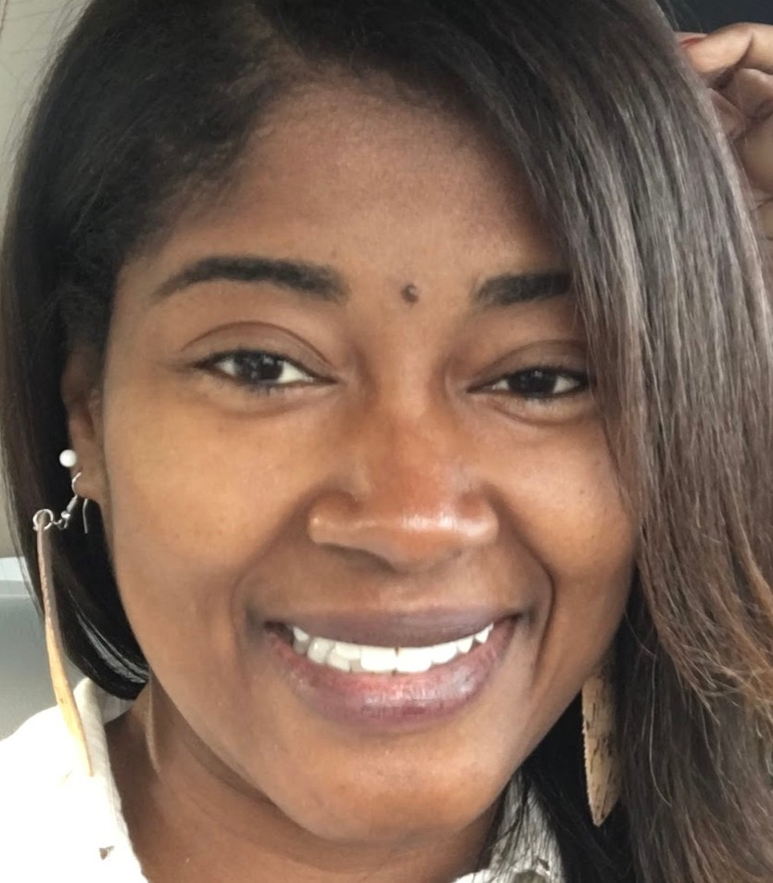
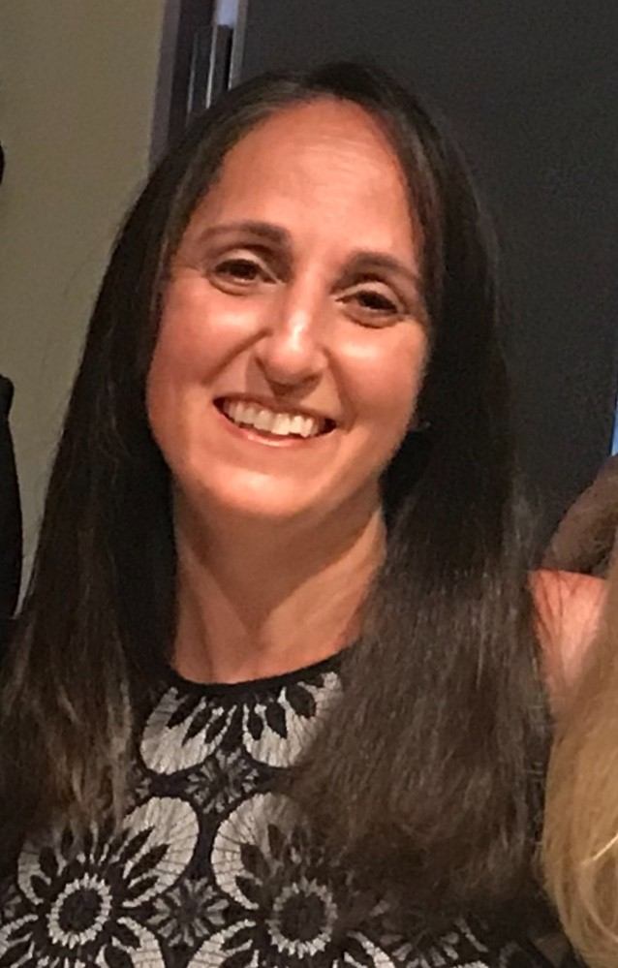
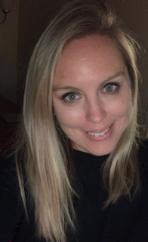
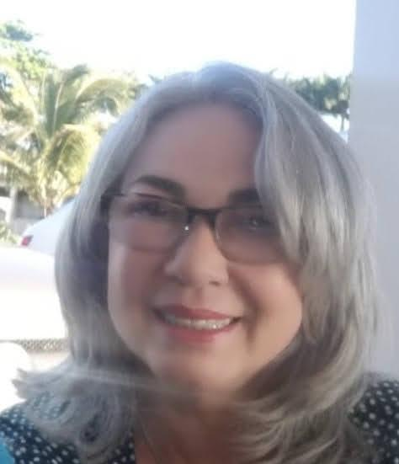
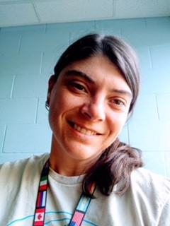
ESOL : Escuela Primaria y Media
Visite el sitio web de ESOL: https://sites.google.com/sccpss.com/hesseesol/home
Escuela Primaria / Elementary School |  |  |  |  |  |  | Escuela Media / Middle School
Pre-escolar / Kindergarten |  | 1º Grado | 2º Grado | 3º Grado | 4º Grado | 5º Grado | 6º Grado | 7º Grado | 8º Grado
Ms. Rhaquay Youmans
ESOL Teacher
Escuela Primaria
rhaquay.youmans @ sccpss.com
Ms Cherie Dennis
ESOL Teacher Escuela Primaria
Cherie.Dennis@ sccpss.com
Ms Amanda Wooten
ESOL Teacher
Escuela Primaria
Amanda.Wooten@sccpss.com
Click on your teacher’s name to see a video introduction
Haga clic en el nombre de su maestro para ver un video de introducción
Ms Kelli
Lawson
ESOL Teacher
Escuela Media
kelli.lawson@ sccpss.com
Ms Lillibeth Hornedo
ESOL para
Escuela Media
lillibeth.hornedo@ sccpss.com

Slide 13
Hesse Information
The Power of PowerSchool
You will want access to PowerSchool’s Parent Access (students’ class assignments, grades, attendance, etc.)
More information: https://spwww.sccpss.com/dad/sis/Pages/Parent-Access.aspx
Request a Parent Access Account:
https://savannahchatham.az1.qualtrics.com/jfe/form/SV_9Sme3EiH8cNFJqt
Parent Access Login:
https://sccpss.powerschool.com/public/home.html
PowerSchool Instructional Video, Parent Access How to Video:
https://spwww.sccpss.com/dad/sis/Pages/Training-Videos.aspx

Slide 14
Hesse K-8 Place-Based Learning Themes
Pre-K and K: Farm to School
1st Grade: Respecting the Environment
2nd Grade: Impact of Organisms on the Environment
3rd Grade: Preserving Coastal Ecosystems
4th Grade: Aeronautics
5th Grade: Patterns in Nature
6th Grade: Ecosystems
7th Grade: Health Services
8th Grade: Engineering
Incorporating
STEAM
into our classrooms through
Place-Based Learning.

Slide 15
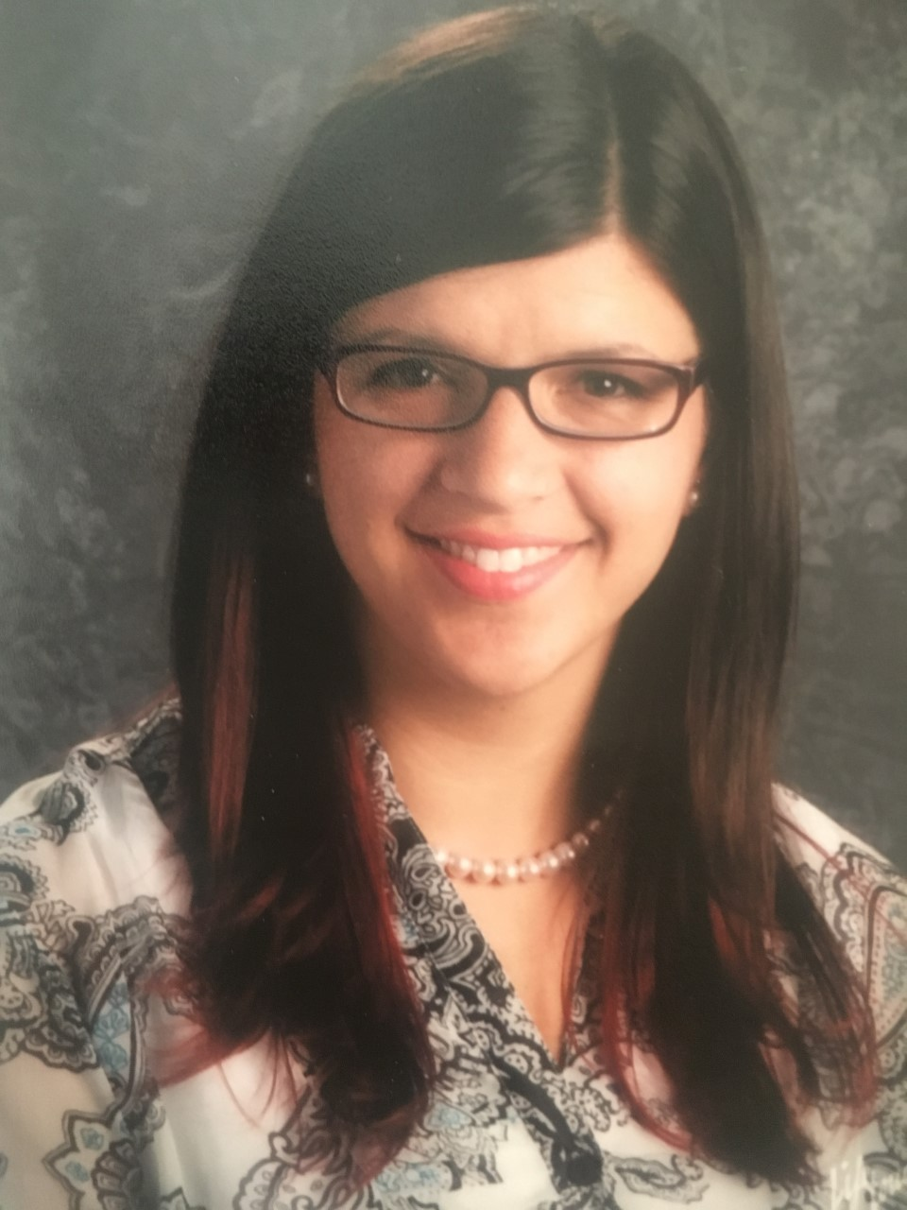
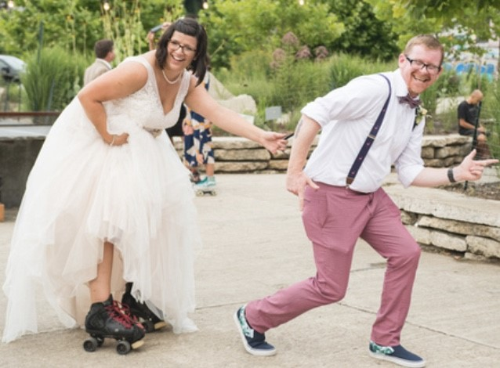
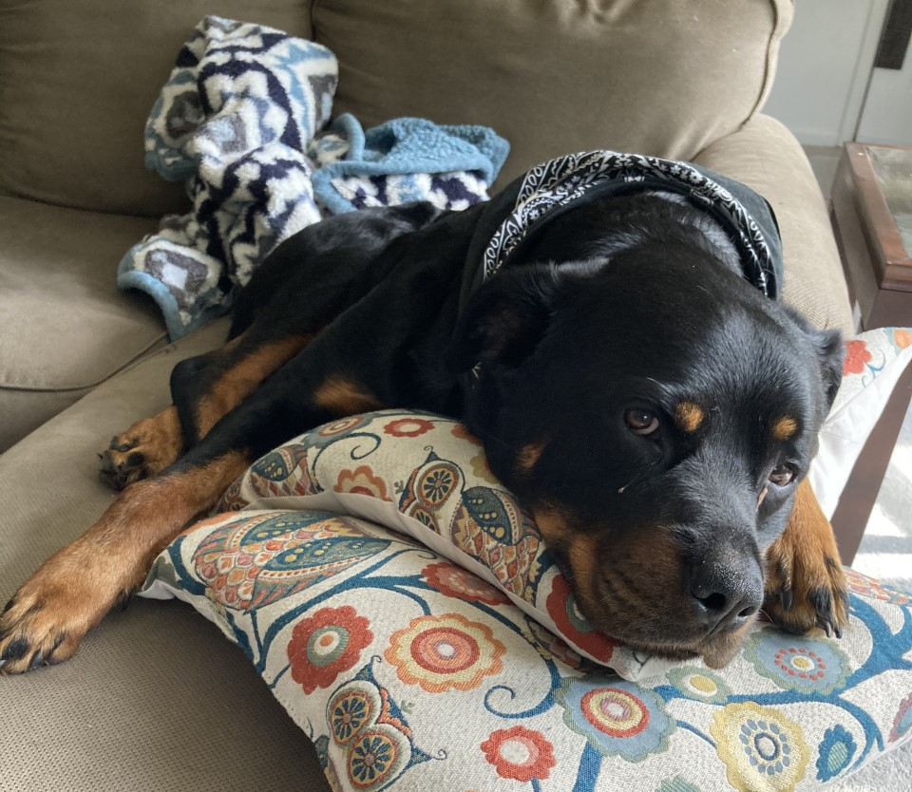
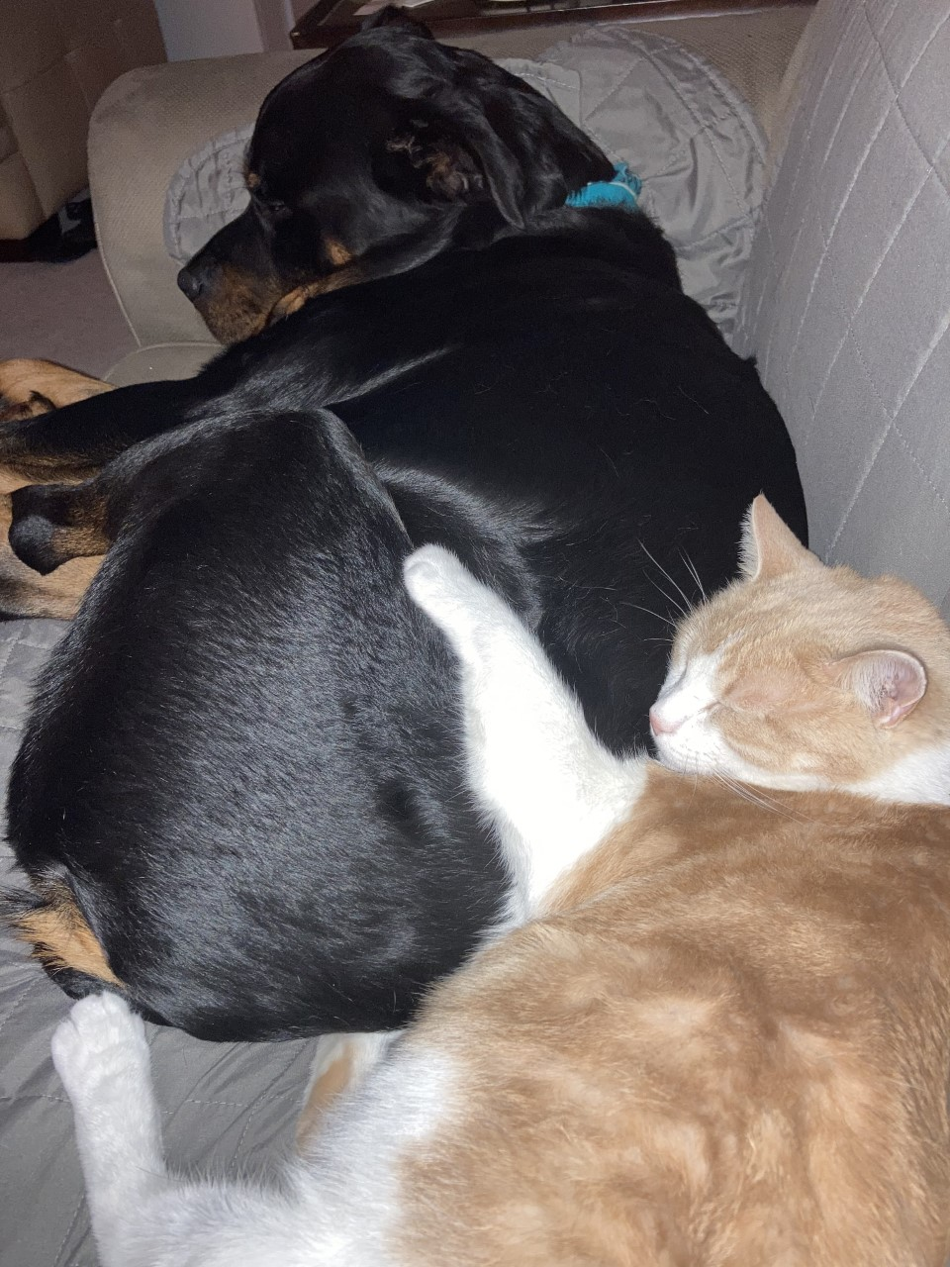
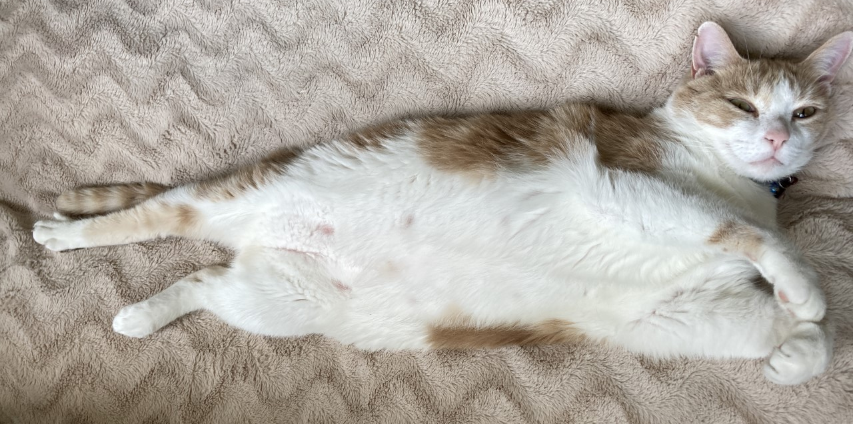
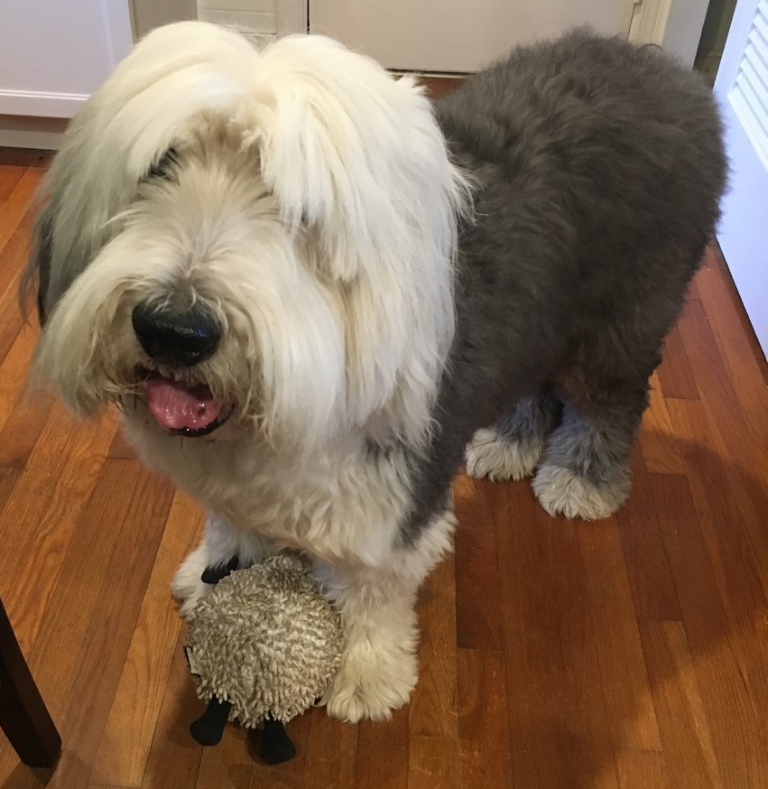
Meet Mrs. Jones & Family
Artax
Mrs. Jones
Claire & Chris Jones
Bastian
Spike
Artax
&
Atreyu
Atreyu

Slide 16
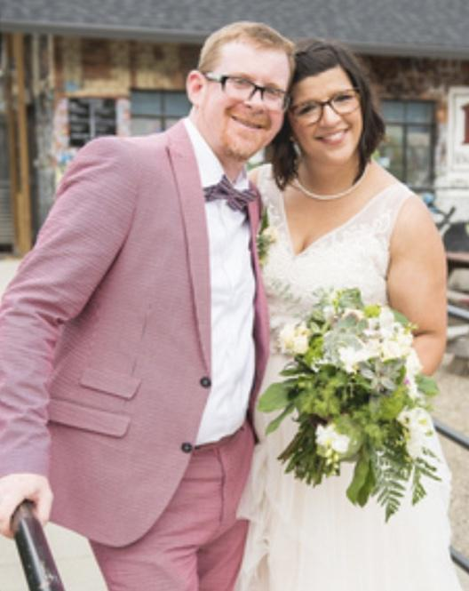
Getting to Know Mrs. Jones
Hello to all my new First Grade students! My name is Mrs. Claire Jones and this is my first year at Hesse! I’m so excited to get to know each of you and to learn everything about Hesse!
I just got married last July to a science teacher and we are expecting our first child in September. We have a Bearded Dragon, Sheepdog, Rottweiler, and a FAT cat! I have been at Isle of Hope for the last 6 years teaching 1st & 4th grades, and had the honor of representing the school as Teacher of the Year in 2020. I am from South Carolina and have a Bachelor’s Degree in Communication and minor in Theatre from Columbia College and a Master of Arts in Teaching from the University of South Carolina. I taught 2nd grade in South Carolina for 2 years and taught in Namibia, Africa for 3 months in 2006. I’m Gifted Certified and have been a mentor teacher for new hires for the past 4 years.
I love to roller skate! I play on the local roller derby team and help coach adults and the Jr. Derby Taunts. I love to play sports, read, and spend time with my family and friends! 1st grade is my favorite grade to teach and I’m so happy to be here! Can’t wait to see you grow and learn! https://jones1stgradehesse.weebly.com/
Hello all...I’m Mrs. Thompson!! Welcome to a great year of
learning! I can’t wait to begin this school year together!
I am certified to teach Pre-K through 5th grade. I received my
undergraduate from the University of Georgia, my Masters from
Piedmont College and my Specialist Degree from Georgia Southwestern University. I am Gifted and ESOL Endorsed.
Most of my time is spent with my family! I have been married for eleven years. I met my husband, Daniel Thompson, at the University of Georgia eighteen years ago. We are blessed with two healthy boys…..a 1st grader (Knox) and a 3rd grader (Garrett). Between the 2 of them, we are always on the go!!

Slide 17
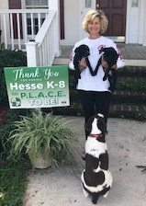
Getting to Know Mrs. Gnann
Hello,
I am Mrs. Lisa Gnann. I will be filling in for Mrs. Jones while she is home taking care of her new baby. I am very excited about being part of your classroom. My teaching career started in 1981. Retirement came 31 years later. I spent years teaching Pre-K, Kindergarten, First Grade and Second Grade. First grade was actually my first teaching job that lasted 12 years. They were wonderful times. After retirement, I started subbing for the Board of Education. I have enjoyed long term subbing at Hesse for many years.
I am married with two daughters that are now married. I have 2 dogs and 1 cat. I volunteer with OneLoveAnimalRescue, Minis2Love (miniature horse therapy) and horseback riding therapy for children.
I am looking forward to meeting you all face to face at Hesse!
Hello all...I’m Mrs. Thompson!! Welcome to a great year of
learning! I can’t wait to begin this school year together!
I am certified to teach Pre-K through 5th grade. I received my
undergraduate from the University of Georgia, my Masters from
Piedmont College and my Specialist Degree from Georgia Southwestern University. I am Gifted and ESOL Endorsed.
Most of my time is spent with my family! I have been married for eleven years. I met my husband, Daniel Thompson, at the University of Georgia eighteen years ago. We are blessed with two healthy boys…..a 1st grader (Knox) and a 3rd grader (Garrett). Between the 2 of them, we are always on the go!!

Slide 18
Classroom Information: itslearning LMS
Learning Management System
https://itslearning.com/global/about-us/resources/overview-video/

Slide 19
Classroom Information: Zoom
Zoom
Login # 859 1430 8674
Password - HesseJones

Slide 20
Virtual Learning Expectations

Slide 21
Classroom Information
What Virtual Learning Looks Like for 1st Grade:
morning meeting, calendar, social time
Engaging lessons for literacy, math, social studies, and science.
lunch & snack time
frequent breaks
connection classes (PE, music, art, computer skills)
If your child qualified for any programs, they will be included in those classes.
Do NOT Stress!
Students will not be on the computer 6 hours per day.
There will be a mixture of live and pre-recorded lessons to meet the needs of everyone. Everything live will be recorded and posted.
Flexible schedule. Virtual learning is for everyone!

Slide 22
Classroom Information: Skills to work on
Learning Letters and Sounds

Slide 23
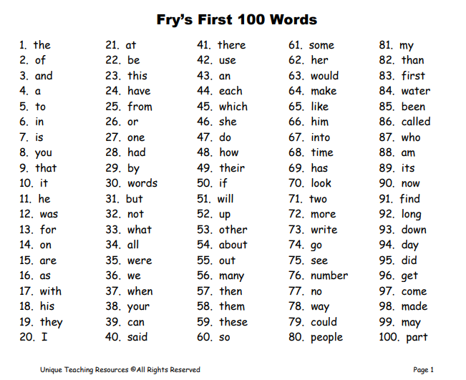
Classroom Information: Skills to work on
Learning Sight Words to 300

Slide 24
Classroom Information: Skills to work on
Fry Words to 300
Reading on Guided Reading Level I.
Write a paragraph with 5 sentences.

Slide 25
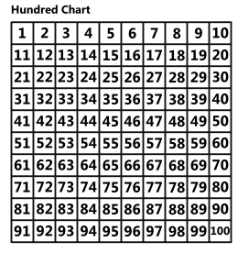
Classroom Information: Skills to work on
Counting to 100
Math Facts!
Add and Subtract
0-10
Add and Subtract
2 digit numbers
(no regrouping)

Slide 26
Classroom Information: Supply List
All students are required to use clear or mesh book bags.
1 one-inch white three ring binder with clear pocket on front cover
1 zippered pouch to fit in binder
4 three-hole paper pocket folders - red, blue, yellow, and green (not All Star brand; not with prongs)
1 plastic supply box (8.5” X 5” no locks)
2 packages of #2 pencils
2 box of 24 crayons
12-pack of glue sticks
1 pair of scissors (no sharp points)
2 wide-ruled composition notebooks (marbled cover)
1 pack of EXPO brand dry erase markers
1 pair of headphones (not earbuds)
2 boxes of tissues
1 bottle of liquid soap
1 bottle of hand sanitizer
Optional: All students may bring a reusable, non-glass water bottle to school. Well-hydrated brains function more effectively!
The following items are requested, but not required:
1 container of disinfectant wipes

Slide 27
Classroom Information: Virtual Supply List
1 plastic supply box (8.5” X 5” no locks)
2 packages of #2 pencils
2 box of 24 crayons
12-pack of glue sticks
1 pair of scissors (no sharp points)
2 wide-ruled composition notebooks (marbled cover)
Handwriting paper and/or wide ruled notebook paper
1 pack of EXPO brand dry erase markers
May want fine tip and larger tip
White Board OR Clear protector sheet
Protector sheets allow use of templates
1 pair of headphones (not earbuds)
At home you may use whichever works best for your family
Folders/Composition notebook use: you may find that it is helpful to have a composition notebook for math and reading so students can easily go back an review information, but a folder will be nice for loose papers.

Slide 28
Contact Information
School Website: http://internet.savannah.chatham.
k12.ga.us/schools/Hesse_Elementary/default.aspx
Classroom Website: https://hesse1stgrade.wixsite.com/hesse1stgrade
Email: jessica.fowler@sccpss.com
Class Dojo: Download the app and I will send
an invite via email!
Office: 912-495-8694

Slide 29
Closing
I know this is a great deal of information, but hopefully it will help you throughout this virtual learning time. We are looking forward to a wonderful year with your child. I understand that each child is different and the teaching methods should vary to ensure each and every child is able to reach his/her maximum learning potential. I want the students to be excited about learning. Let’s work together to make this a happy and successful year for your child!
Thank you so much for attending.

Slide 30
Thank you for coming.
SCCPSS Parent Guide: https://spwww.sccpss.com/Documents/PARENT%20GUIDE%20booklet%20SY2020%202021%20VIRTUAL%20LEARNING882020.pdf

